Slide 1
52K
CAPSTONE PROJECT
Total Transactions
Fintech Transaction
Analytics
1.43bn
Total Transaction Value
Comprehensive Data Analysis | SQL · Power BI · Excel
4.95%
Overall Fraud Rate

Slide 2
TEAM DETAILS
BATCH 5
NAME | ENROLLMENT NO.
Diya Jalandhra | 2506172250002
Vishnu Pratap Singh | 2506142270025
Vanshika Chauhan | 2506142270009
Thapar Harman Jeetendra | 2506172000397
Nikhil Kumar | 2506142000606
Ankita Verma | 2506142270006

Slide 3
Objective of the Project
Business Problem & Analytical Goals
1
Fraud Detection
Identify and quantify fraudulent transactions across merchant categories, regions, and account types to support proactive risk management.
2
Transaction Performance
Analyse success vs. failure rates by payment method, device type, and region to pinpoint friction points in the payment pipeline.
3
Revenue & Fee Optimization
Evaluate processing fee structures across currencies (USD, EUR, INR) and account types to identify cost-efficiency opportunities.
4
Customer Behaviour
Segment high-value and high-frequency customers to enable targeted retention and upsell strategies.
5
Operational Insights
Surface regional and channel-level patterns to guide resource allocation and infrastructure investment decisions.

Slide 4
Dataset Overview
Source, Structure & Scope
SOURCE
SIZE
PERIOD
FORMAT
Simulated Fintech
Transaction Dataset
51,500 Rows
17 Columns
2023 – 2027
(Multi-year)
CSV / Excel
Cleaned Data
Key Variables
Transaction_ID
Unique identifier per transaction
Merchant_Category
Travel / Food / Healthcare / Electronics / Retail
Customer_ID
Customer reference number
Region
East / West / North / South / Central
Amount
Transaction value (0.36 – 59,999.63)
Currency
USD / EUR / INR
Account_Type
Current / Savings / Credit / Unknown
Device_Type
Mobile / Desktop / Tablet
Transaction_Status
Success / Failed / Pending / Unknown
Processing_Fee
Fee charged per transaction
Is_Fraud
Binary fraud flag (0 = clean, 1 = fraud)
Payment_Method
Card / UPI / Wallet / Net Banking

Slide 5
Data Cleaning & Preparation
Steps Performed in Excel & SQL
Missing Value Handling
Duplicate & Integrity Check
'Unknown' values in Account_Type, Region, Device_Type, Payment_Method - retained as a category (not imputed) to avoid analytical bias
~25% of rows contained at least one Unknown field across key dimensions
Allowed Unknown to participate in aggregations to ensure completeness of counts
Verified uniqueness of Transaction_ID across all 51,500 rows - zero duplicates found
Customer_ID duplicates expected and valid (one customer → multiple transactions)
Is_Fraud confirmed as strict binary (0/1) - no nulls or mixed types detected
01
02
Data Type & Format Validation
Derived & Normalised Columns
Transaction_Date parsed to proper date format (DD-MM-YYYY) for time-series analysis
Amount and Processing_Fee confirmed as numeric - no corrupted text values found
Currency codes standardised: USD, EUR, INR only - no rogue entries
Month column extracted from Transaction_Date to enable monthly trend analysis in Power BI
Normalised_Rate calculated as Amount × Conversion_Rate for fair cross-currency comparison
Processing_Fee ratio derived against Amount to analyse fee burden per transaction
03
04

Slide 6
SQL Analysis - Insights & Results
Data-Backed Findings from Each Query
₹1,83,385
Customer #2180 recorded the highest total spend - 2× the dataset average - identifying a critical high-value segment for retention programs.
₹1.48 Cr
2,548 fraudulent transactions totalled ₹1,48,10,986. Healthcare is the most affected category - requiring targeted rule-based monitoring.
Highest Customer Spend
Total Fraud Amount
12,837
24.9% of all transactions failed - the highest single-status failure rate. Payment gateway reliability is the #1 operational risk.
Mobile
Mobile transactions include negative amounts - indicating unreconciled refunds/reversals. Requires gateway-level reversal tracking.
Failed Transactions
Highest Device Volume
₹59,989
Top 10 amounts cluster near the ₹59,989 ceiling - confirming a high-ticket transaction segment that drives outsized revenue per event.
North
North region records the highest top-value transactions AND the most fraud cases (453) - a dual risk of high exposure and high fraud.
Top Transaction Value
Highest Fraud by Region
~₹27,500
All account types (Current, Savings, Credit) show near-identical averages within ₹145 - account type does not predict spending level.
₹43.15L
EUR generates the highest fees (₹43.15L) vs USD (₹42.99L) and INR (₹42.79L). EUR fee loading is a silent margin drain.
Avg Spend (All Accts)
EUR Processing Fees (Top)
8,842
Food (8,722) and Travel (8,746) dominate merchant volume. Unknown category (8,610) signals a major POS data-capture gap.
15+
Customers #1232, #4419, and #6947 each completed 7 transactions - well above average. Prime candidates for loyalty program targeting.
Food + Travel Txns
High-Frequency Customers

Slide 7
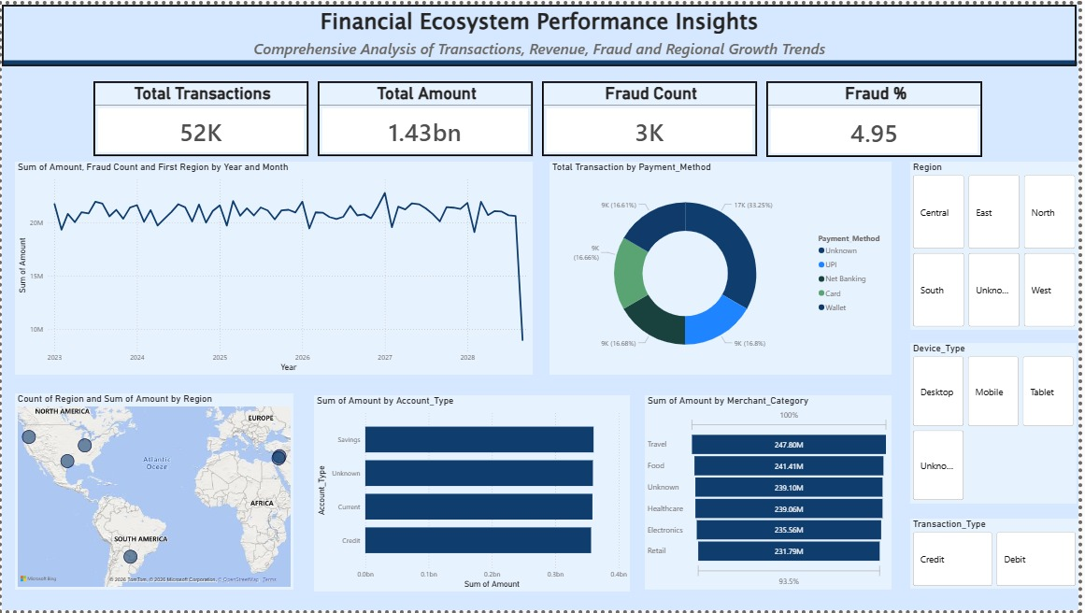
Power BI Dashboard
Financial Ecosystem Performance Insights
KPI Cards
52K txns · 1.43bn total · 3K fraud cases · 4.95% fraud rate
Time-Series Line
Stable ~20M monthly volume through 2027, sharp drop in 2028 (data tail)
Payment Method
Unknown (33.25%) dominates - UPI, Wallet, Net Banking, Card each ~16.6%
Account Type Bar
All 4 types (Savings/Unknown/Current/Credit) show equal ~0.3bn spend
Merchant Bar
Travel (₹247.8M) > Food (₹241.4M) > Unknown > Healthcare > Electronics > Retail
Filters Applied
Region · Device_Type · Transaction_Type slicers enable drill-down analysis

Slide 8
Dashboard Insights
Results & Findings from Power BI Analysis
💡 33.25% of transactions have Unknown payment method - over 17K records with no payment attribution, the single largest data gap in the dataset.
📈 Travel (₹247.8M) leads merchant revenue, outpacing Retail (₹231.79M) by ₹16M - a 6.9% differential that highlights sector concentration risk.
⚡ All account types generate near-equal transaction amounts (~₹0.3bn each), confirming that account-type is not a revenue differentiator for product targeting.

Slide 9
Key Insights
Data-Backed Business Findings
High Failure Rate - Revenue at Risk
Fraud Hotspot: Healthcare + North Region
01
24.9% of transactions failed - nearly 1 in 4. Combined with 24.8% Unknown status, over 49% lack confirmed success. Every 1% recovery = ₹14.3M in recaptured revenue.
02
Healthcare leads fraud by category (450 cases); North leads by region (453 cases). This is a concentrated, not random, pattern - requiring geo-specific automated rules.
EUR Generates Highest Processing Fees
Account Type Has No Spending Predictive Power
03
EUR: ₹43.15L | USD: ₹42.99L | INR: ₹42.79L. EUR extracts the highest fee load - a hidden margin cost for businesses operating in EUR corridors.
04
All account types average ~₹27,500 (spread: ₹145). Blanket product promotions by account type will not drive differentiated revenue. Merchant category is a better targeting lens.
Repeat Customers Signal Loyalty Potential
Unknown Data = 25% Analytical Blind Spot
05
15+ customers made 6–7 transactions each. Customers #1232, #4419, #6947 completed 7 each. These high-frequency users represent premium upgrade and loyalty reward targets.
06
33.25% Unknown Payment_Method · 25% Unknown Device_Type · 25% Unknown Account_Type. This tagging failure limits every downstream model, segment, and attribution analysis.

Slide 10
Conclusion
What the Analysis Reveals & Business Implications
What the Analysis Reveals
Business Implications
The platform processes 52K transactions worth ₹1.43bn, but only ~25% confirm as successful - a structural payment infrastructure failure, not a demand shortfall.
Fraud (4.95% rate, ₹1.48 Cr value) is geographically and categorically concentrated in Healthcare + North - enabling a targeted, not blanket, fraud response strategy.
Currency fee structures are unequal - EUR extracts the highest fees, creating hidden cost asymmetry across regions and currencies.
Account type is a poor predictor of spending; merchant category (Travel > Food > Healthcare) is a far stronger revenue signal for targeting and product design.
The ~25-33% Unknown rate across Device, Payment Method, and Account Type is the single most impactful data quality issue - it undermines every ML and BI model built on this data.
Revenue Leakage
25% failure rate = direct revenue loss. 1% improvement → ₹14.3M recovered.
Fraud Cost
₹1.48 Cr fraud requires immediate Healthcare + North geo-fencing rules.
Fee Margin Risk
EUR fee loading warrants processor renegotiation or pass-through pricing.
Data ROI
Fixing the Unknown gap alone improves segmentation accuracy by ~25–30%.

Slide 11
Recommendations
Practical, Data-Driven Actions
Fix Payment Failure Pipeline
Deploy Targeted Fraud Rules
R1
24.9% failure is 3–4× industry benchmark (6–8%); audit gateway retry logic immediately
Introduce real-time webhook callbacks to eliminate 24.8% 'Unknown' transaction status
Onboard secondary payment processors for high-failure corridors
R2
Flag velocity: >3 Healthcare transactions in <1 hour from North region
Set amount thresholds for Mobile + Healthcare combination (highest fraud overlap)
Use 2,548 confirmed fraud cases as ML training data for real-time scoring
CRITICAL
HIGH
Fix Data Tagging at Source
Loyalty Program - High-Freq Customers
R3
Mandate Device_Type and Payment_Method at API level - not optional fields
Replace Unknown Account_Type with mandatory onboarding dropdowns
Reject transaction batches below 90% field-completion rate
R4
Upgrade customers with 6–7 transactions to premium tier with fee cashback
Use merchant category history to personalise reward offers
Monitor monthly cadence: flag customers showing frequency drop
HIGH
MEDIUM
EUR Fee Renegotiation
Boost Retail Merchant Acquisition
R5
EUR fees (₹43.15L) exceed USD and INR - open processor renegotiation
Model impact: 5% EUR fee reduction = ~₹2.15L annual saving
Consider EUR surcharge pass-through for high-volume B2B clients
R6
Retail (₹231.79M) lags Travel (₹247.8M) by ₹16M - targeted merchant campaign needed
Offer 0% processing fee for first 100 Retail transactions
Identify Retail-Travel customer overlap for cross-sell targeting
MEDIUM
LOW

Slide 12
Limitations & Future Scope
Current Constraints & Expansion Opportunities
Limitations
Future Scope
Simulated Dataset
ML Fraud Detection Model
Synthetically generated data - findings reflect methodology, not live market dynamics. Real-world validation required.
Train Random Forest / XGBoost on 2,548 fraud cases for real-time probabilistic fraud scoring with risk tiers.
High Unknown Rate
Customer Lifetime Value
25–33% untagged records in Device_Type, Payment_Method, Account_Type. Limits segmentation accuracy and model reliability.
Build CLV model using transaction frequency, amount, and tenure to proactively identify and retain high-value customers.
No Time-Series Depth
Real-Time Power BI
Dates span 2023–2027 but monthly granularity is thin. Dense month-on-month data needed for true seasonality analysis.
Connect Power BI to live SQL / streaming source for real-time transaction monitoring and fraud alerting dashboards.
No Demographics
NLP Merchant Classification
No age, income, or location data - prevents behavioural segmentation and demographically-weighted fraud risk modelling.
Apply NLP clustering on 8,610 Unknown merchant records to auto-classify them into meaningful transaction categories.
Static Fraud Labels
Churn Prediction Engine
Is_Fraud is a pre-labelled binary - not derived from pattern detection. Real fraud models require dynamic probabilistic scoring.
Analyse frequency drop-off patterns to predict customer churn 30–60 days ahead and trigger proactive retention offers.

Slide 13
52K
Transactions
THANK YOU
10
SQL Insights
Fintech Transaction Analytics - Capstone Project
8
BI Visuals
6
Key Findings

